Slide 1

Infrastructure Automation or how you can stop worrying and love Ansible

Slide 2
Intro
I am Arthur Freyman
You can find me at golovast@gmail.com
http://www.mindend.com

Slide 3
Intro
5-6 engineers on the team
70+ roles
50+ playbooks
Few thousand servers
Diverse ecosystem of apps
Notes:
Talk about background. Worked with chef and was burned by it. Some work with puppet, go as far back as shell scripts. We all know that they sucks.
Mention that this is not an introduction talk. Assumes that you already know a bunch about ansible.

Slide 4
Context
TMTOWTDI - There is more than one way to do it
Figure out what works for your team
Notes:
Mention GumGum’s approach. This is a different one. Talk about how the size of the team will impact your choices.

Slide 5


Goals
Quality
Rapid Iteration - move fast
Safe – move fast and break things
Notes:
Mention GumGum’s approach. This is a different one. Talk about how the size of the team will impact your choices.

Slide 6

Goals
No hands – infrastructure as code
Team can work together on a shared codebase
Notes:
Mention GumGum’s approach. This is a different one. Talk about how the size of the team will impact your choices.

Slide 7
Style Guide
Helps with code reviews
Helps the team work together
Testable (sometimes)
Convention over configuration
Notes:
Easier to debug the roles. Helps someone pick up the role and just work on it when they know what to expect.

Slide 8
Style Guide
Role & Playbook namespacing
All roles are - r-RoleName
All playbooks are - pb-PlaybookName
Playbook Name == App Repo Name
Notes:
This isn’t that important. But helps perhaps with other tooling that you might have around. Easy discoverability for glue code.

Slide 9
Style Guide
All variables are prefixed with the role name*
Default variables go into vars/ and are all UPPERCASE
Overridable variables go into default/main and are all lower case
* Avoids collisions
Notes:
Easier to debug the roles. Helps someone pick up the role and just work on it when they know what to expect.

Slide 10
Style Guide
Prefer to leave overridable role variables unset. “Explicit is better than implicit”
Clear examples in comments/readme or a sample file
Notes:
This is somewhat debatable. Wanted to be explicit about what you set at the playbook level and remove surprises. Depends on the audience and what you expect them to control and the level of abstraction you’re providing.

Slide 11
Style Guide
Minimize or eliminate hard coded values
Users
Paths
etc

Slide 12
Style Guide
Avoid giant tasks files
Split them along some function
Notes:
Split them up by function. Easier to troubleshoot and read.

Slide 13
Style Guide
Lots of comments – especially when doing weird things
Use tags liberally and explain in the readme

Slide 14
Style Guide
Logical boundaries
Don’t bundle things together, use separate roles
Notes:
You get proliferation of roles and sometimes it’s tempting, but it will help prevent mistakes later. Unless something has no reason to exist by itself, try not to bundle it together. Example might be passenger and RVM, java and say elastic search.

Slide 15
Style Guide
All roles are started with ansible-galaxy init
test.yml in test/ must be runnable
Notes:
You get proliferation of roles and sometimes it’s tempting, but it will help prevent mistakes later. Unless something has no reason to exist by itself, try not to bundle it together. Example might be passenger and RVM, java and say elastic search.

Slide 16

Follow Zen of Python (PEP 20)
Special cases aren’t special enough to break the rules
Although practicality beats purity
Notes:
Sometimes things just won’t fit the style guide. Don’t try to fit a square peg into a round hole. Keep in mind that a style guide is a living document. Though try to keep it additive rather than wholesale changes. It only exists to help you.

Slide 17
Versioning and dependencies
All roles and playbooks in separate repos
Helps with versioning
Helps with feature branch development
Enables strong version locks
Notes:
Talk about this in detail. One of the better decisions we’ve made. When you lock to a particular role version, you know that it’s set. Especially when you have multiple dudes working on the same repo.

Slide 18
Versioning and dependencies
Two places to do versioning
requirements.yml
Role metadata
Git submodules might be interesting to explore
Decided to handle dependency at playbook level
Notes:
Subject of much debate. Burned by chef. No perfect answer there. Explicit readme in the role and checks for pre-reqs to protect the user.

Slide 19
Versioning and dependencies
Ansible-galaxy install –r requirements.yml
# from github installing to a relative path
- src: git+ssh://git@github.com/Company/r-role
path: roles/
version: 0.0.1
name: r-role
Notes:
Subject of much debate. Burned by chef.

Slide 20
Roles
Pick and choose how much work to put in a role
Some are real simple – generics
Others can be complex with edge cases
Notes:
Can handle complicated scenarios in some roles. Generics are fine. Maybe it’s just a placeholder for something later. You could just be installing a package and doing a handful of things.

Slide 21
Roles
Unix philosophy – do one thing and do it well
DRY
Keep things modular
Notes:
Can handle complicated scenarios in some roles. Generics are fine. Maybe it’s just a placeholder for something later. You could just be installing a package and doing a handful of things.

Slide 22
Roles
Some java app
Bad: single role for configuring system, installing pre-reqs and pushing the app
Good:
Role/jvm
Role/tomcat
Role/users
Role/sys_config
Role/code_deploy
Notes:
Can handle complicated scenarios in some roles. Generics are fine. Maybe it’s just a placeholder for something later. You could just be installing a package and doing a handful of things.

Slide 23

Roles
Roles from Ansible Galaxy

Slide 24
Roles
Ansible Galaxy
Hit or miss
Sometimes a decent start
Usually need work

Slide 25
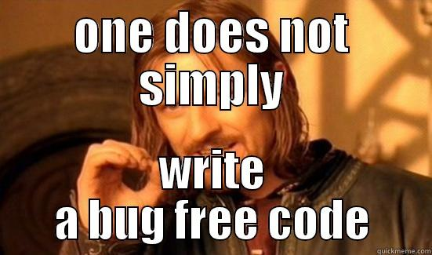
Roles
Template logic
Sometimes necessary
Try to avoid very complex things
Debugging is a PITA
Notes:
This is generally the most powerful tool you have in ansible, short of writing modules. Pain in the ass to debug

Slide 26
Roles
Template logic
{% for k,v in item.server.locations.items() %}
{% for x in v %}
{% for d, e in x.items() %}
{% if d == 'path' %}
location {{ e }} {
{% else %}
{{ d }} {{ e }};
{% endif %}
{% endfor %}
{% endfor %}
{% endfor %}
Notes:
This is generally the most powerful tool you have in ansible, short of writing modules. Pain in the ass to debug

Slide 27
Playbooks
Add task timings
Build-in in ansible 2.0 (callback_whitelist = profile_tasks)
https://github.com/jlafon/ansible-profile

Slide 28
Playbooks
Have a task to dump all variables
https://coderwall.com/p/13lh6w/dump-all-variables

Slide 29
Playbooks
Have a task to dump all variables
{{ vars | to_nice_json }}
{{ environment | to_nice_json }}
{{ group_names | to_nice_json }}
{{ groups | to_nice_json }}
{{ hostvars | to_nice_json }}

Slide 30
Deployments
Capistrano became Ansistrano
Started with deploying the entire playbook per app
Notes:
I don't want to to necessarily get too much into it. It's a bit orthogonal to ansible, plus this could be a whole topic in itself.

Slide 31
Deployments
Capistrano became Ansistrano
Started with deploying the entire playbook per app – dynamic inventory
Notes:
I don't want to to necessarily get too much into it. It's a bit orthogonal to ansible, plus this could be a whole topic in itself. That wasn't efficient in a lot of ways, but at least made sure things are indempotent.

Slide 32

Deployments
Evolved to a deploy tag method
Optimized for speed
Added functionality like rollback
Notes:
worked pretty well.

Slide 33
Deployments
Eventually moved to an AMI-style deploy
Ansible still configured images
Used a layer-style method
Notes:
worked pretty well.

Slide 34
AMI Deploys
Notes:
worked pretty well.

Slide 35

Testing
Roles are tested like app code
Use a build system (Jenkins)
Notes:
Larger team and if complex system, it allows to work on the project together in an easier way. I may not know what the other guy is doing or maybe he left. I can feel more comfortable modifying something if there is a good test for it.
We all forget shit. It helps to modify things later. Be considerate of future us who will have to maintain and debug this code months or even years down the line.
Somewhat impress the developer organizations. Show that you follow similar practices and pay attention to code quality.

Slide 36
Testing
Syntax check
- Ansible-playbook --syntax-check --list tasks
Ansible-lint (https://github.com/willthames/ansible-lint)
Notes:
Linter is great. You can add your own rules there to comply with the style guide.

Slide 37
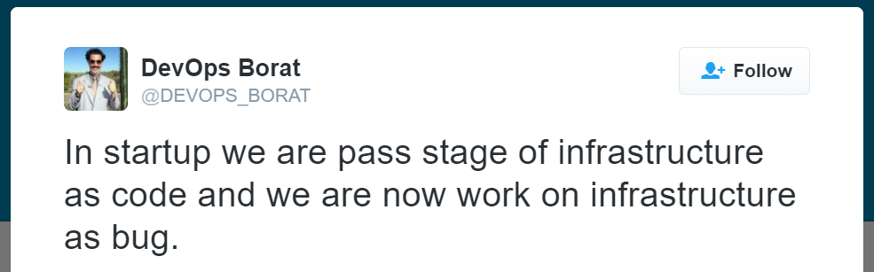
Testing
Assert module
Serverspec, inspec, rolespec, testinfra, goss, ansible_spec, test-kitchen
Test playbooks
Notes:
Many different ways of doing it. Lint is a form of a unit/functional test. Syntax checking is always helpful. Writing test playbooks is a good thing.

Slide 38
Testing
Auto test roles on repo push
Bumpversion (https://github.com/peritus/bumpversion)

Slide 39
Testing
Test your expectations
Files
Services
Packages
Users
Multiple variations (different sets of variables)

Slide 40
Testing
Use native tools for template validations
vars:
- validate_conf: /usr/sbin/named-checkconf
tasks:
- name: install named.conf
action: template src=named.conf.j2 dest=/etc/named.conf validate = ‘{{ validate_conf }} %s’

Slide 41
Testing
Other validators
/usr/bin/nginx –t –c nginx.conf
apachectl configtest
/usr/sbin/sshd –t
/usr/sbin/squid –k check
/usr/libexec/mysqld --defaults-file=test-my.cnf –verbose –help 1 >/dev/null
syslogd –f /etc/rsyslog.testing.conf -d

Slide 42
Testing with Testinfra
def nginx_present(Package):
nginx = Package(“nginx”)
assert nginx.is_installed
def nginx_running_enabled(Service):
nginx = Service(“nginx”)
assert nginx.is_running
assert nginx.is_enabled

Slide 43
Testing with Serverspec
describe user(‘nginx’) do
it { should exist }
it { should belong_to_group ‘nginx’}
end
describe process(‘nginx’) do
it { should be_running }
its(:user) { should eq ‘nginx’ }
end
describe port (80) do
it { should be_listening }
end

Slide 44
Testing with Serverspec (cont)
describe “Server Configuration” do
it ‘should response with right status code’ do
uri = URI(‘http://localhost’)
http = Net::HTTP.new(uri.host)
request = Net::HTTP::Get.new(uri)
response = http.request(request)
expect(response.code).to eq(‘200’)
end
end

Slide 45
Testing with Goss
New tool – written in go
Builds yaml files (sort of automatically)
`goss autoadd nginx`

Slide 46
Testing with Goss
package:
nginx:
installed: true
versions:
- 1.4.1-3ubuntu1.3
nginx = Package(“nginx”)
assert nginx.is_installed
service:
nginx:
enabled:true
running:false

Slide 47
Tips & Tricks
Some things I’d do differently & cons

Slide 48

Tips & Tricks
Tests weren’t always there or awesome
Testing on prod:
Notes:
Sometimes I wished we enforced that better. But tradeoffs have to be made.

Slide 49
Tips & Tricks
Careful with variable registration. This doesn’t work:
- shell: /usr/bin/foo
register: foo_result
- shell: /usr/bin/bar
when: foo_result
Notes:
Sometimes I wished we enforced that better. But tradeoffs have to be made.

Slide 50
Tips & Tricks
Beware of loops – not very powerful
Two sided coin with:
with_items
with_nested
with_dict
with_indexed_items (gets array position)
Notes:
They aren’t that powerful.

Slide 51
Tips & Tricks
Lookup plugin – awesome (Ansible 2.0)
ini
csv
dns
Notes:
They aren’t that powerful.

Slide 52
Tips & Tricks
Versioning slows down workflow
Maybe should have versioned Playbooks too
Notes:
Takes a little while to get used to it. When multiple people are working on a role. Doesn’t happen too frequently, but enough times to make it annoying. More or less typical of the feature branch workflow.

Slide 53
Tips & Tricks
Clusters will make you break rules

Slide 54
The end
Any questions ?

